Slide 1

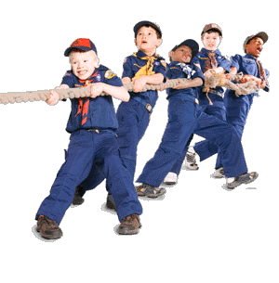
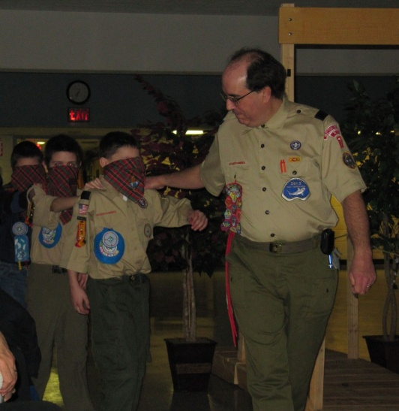
PRESENTATION ON CO-CURRICULUM
SPORTS TOURNEY FOR CUBSCOUTS
BY: RANIA ALI
VILLA COLLEGE

Slide 2
Introduction
What is Cub scout?
exciting and fun filled experiencing uniform activity
gives a lot of opportunity to young boys to develop their full potential to build a good citizenship.
Therefore, this assignment focuses on initiative activities that will assist cub scouts to be physically, spiritually, and mentally fit through various sports, and physical games.

Slide 3
AIM
The aim of the activity is to enable cub scouts to learn new techniques and procedures, increase studentship skills, remind goals for a good sportsmanship, and have fun and to give an insight of a boy scout.

Slide 4
Objectives
By participating in the program students will develop physical fitness abilities, and discover and acquire new skills and talents through hard work.
Cub scouts will be acknowledged for enjoying cooperation, collaboration and teamwork to promote success in activities.

Slide 5
About the activity – Cub Scout sport outing
One day outing – Aa-rah
40 cubscouts
15 teachers
5 sport persoms
2 health assistants

Slide 6
The outing for cub scouts comprises of initiative outdoor games and sports, which we have modified based on the different sports played around the world.
Outdoor games and sports provide the opportunity for every Cub Scout to learn the basic skills of a sport, game, or competition while learning good sportsmanship and habits of personal fitness in an environment.

Slide 7
The outdoor sports and games of ‘Sports tourney’ includes, shot ball, sightless soccer, Frisbee throwing, triangular tug of war, and net diving.

Slide 8

Risk awareness and management
first step-
all officials and participants oriented for the types of injuries or risks that may occur during the session., This will raise awareness of specific topics, such as symptoms that might be related to concussion and many assist in compliance with injury management and prevention

Slide 9
To minimize injuries and loss and their effects on the sport or in short to manage the risk:
Ensure that officials have adequate training in first-aid, and have qualified sports persons in teaching the skills.
Screen cub scouts for health limitations that may make it unsafe for them to participate in the program.
Ensure that first-aid kits, and other safety equipment are in place and in good condition.
Ensure that cub scouts and officials are wearing appropriate clothing and using appropriate equipment.
Record names and contact information if an incident happens. Develop a plan for serious injuries like ambulance and assistance from M.N.D.F as it is an outing held in an island.

Slide 10
Debriefing and Evaluation
Before the closure the participants and officials will sit together and discuss the main points of the session and will get to know the things went well, and identify rooms for improvements. The discussion includes:
* what they have learnt or how effectively and efficiently they accomplished the duties
* identify the hardest thing to achieve
* how well they got along with each other
* the skills they would prefer for next outing
* additional resources needed
* the next venue for such a program.

Slide 11
Shotball
Objectives: to pass the ball successfully for 10 times and win a goal to score one point or to pass the ball successfully for 12 times and win two goals to score two points
Resources: Basketball or netball or any kind of ball of that size, twin rings
This sport is a modified and a combination of both netball and basketball’s rules and skills. The game is played between two teams in a competitive environment to improve their coordination skills.
Safety considerations: As there is lot of players, to avoid injuries avoid playing roughly.

Slide 12
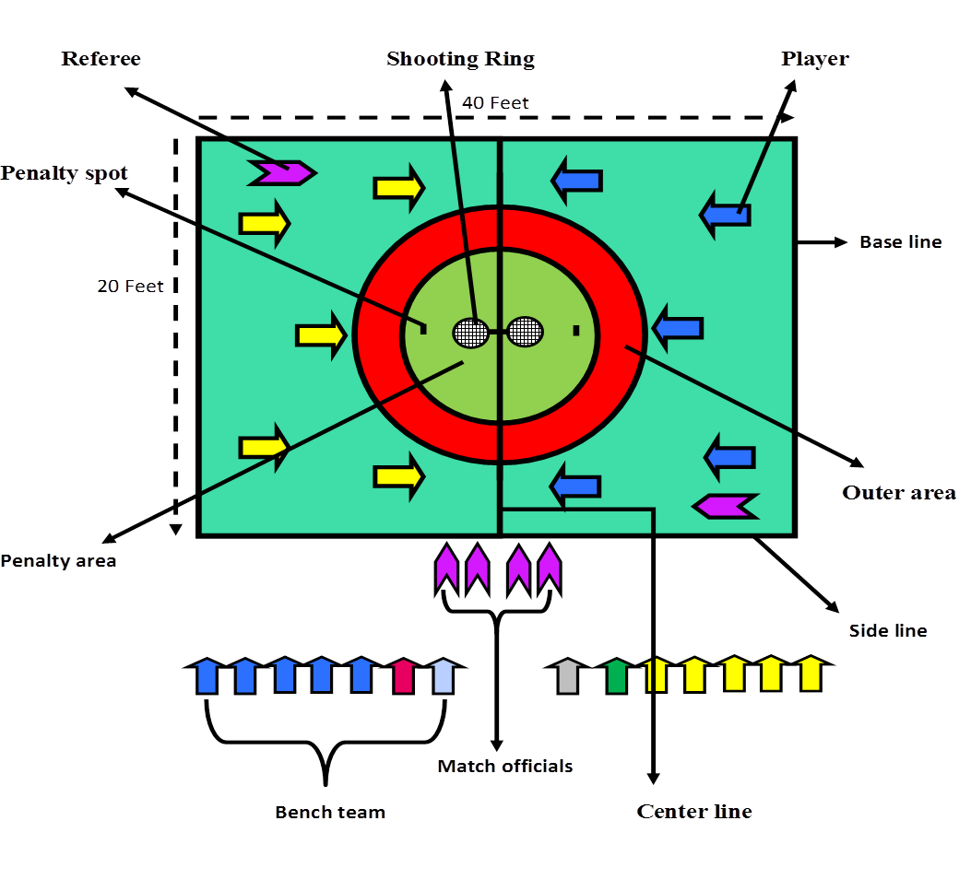
Shotball

Slide 13
Sightless soccer
Objectives: To pass the ball to the opponents side and hit the bar to score.
Resources: football, blind folds, rattle ball
This sport is a modification of blind soccer. According to Byl, J. (2002), blind soccer is played by half of the team blindfolded and other half without blindfold, and players walk with the ball to reduce risk. However in sightless soccer, of the five players four players of the team will be blindfolded and one without blind fold (leader) and players can run with the ball if they have confidence.
As there will be no goals, players have to pass the ball to the opponent’s side and hit the bar to score. The one who is without blind fold will communicate others to ensure for the right direction to kick the ball.
Safety considerations: As most players are blind folded caution them to pay attention to the leader and coaches.

Slide 14
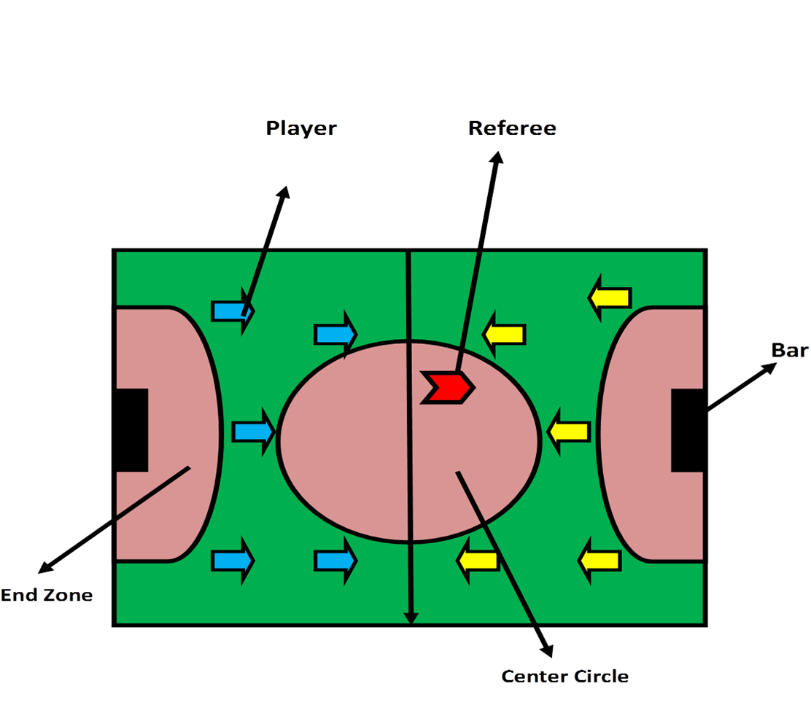
Sightless soccer

Slide 15
Frisbee throwing
Objectives: To throw Frisbee to the opponent’s goal
Resources: Frisbee/flying disk, 2 goals (fixed 3ft above the ground)
This is a modification of Ultimate which is played between two teams of seven players on a large rectangular pitch. According to WFDF Rules of Ultimate 2009, a line drawn across the pitch at either end creates two "end zones" (like in American Football), which is the goal-scoring areas. A goal is scored when a team completes a pass to a player standing in the end zone and players cannot run with the disc. Players have to a stop and throw it to another player.
However, this game will be played in a circular pitch where two goals fixed 3ft above from the ground. Players can’t run with the Frisbee but they can take 3 steps. A goalie will be there unlike Ultimate. Players will throw Frisbee to the opponent’s goal to score.
Safety considerations: As there are lots of players, to avoid injuries avoid playing roughly.

Slide 16
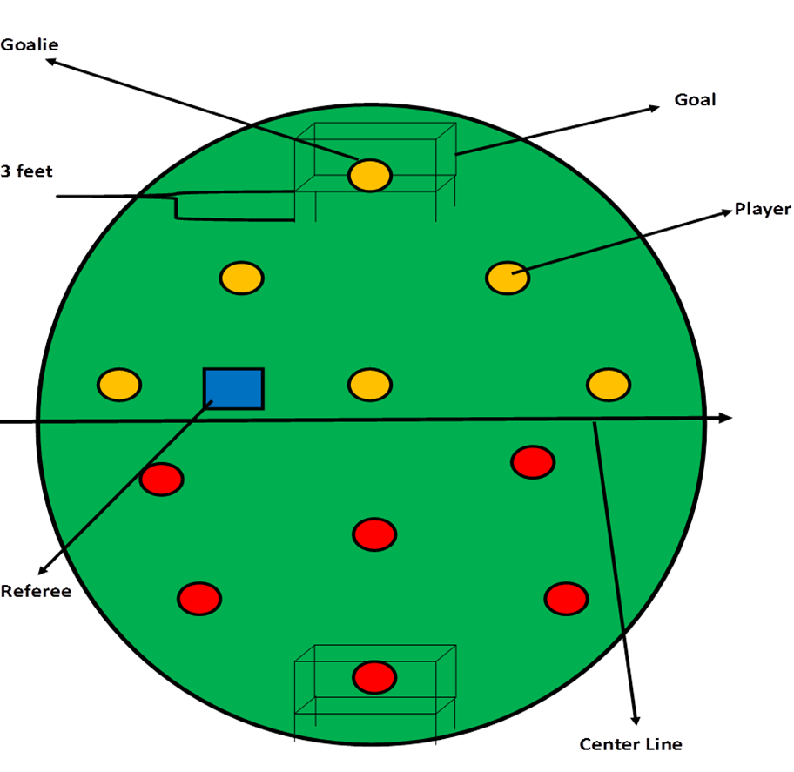
Frisbee throwing

Slide 17

Objectives: To pass the rope beyond the marked/ end line
Resources: 3 ropes of 10 feet, 1 rope of 6 feet
Normally tug of war is performed by two teams lining up and pulling in a single rope. However, in triangular tug of war cub scouts will tie knots and make an equilateral triangle and the long rope will be knotted at the corners. Three teams will pull and the team that can pass the opponents marked/ end line will win.
Safety considerations: Surrounding area must be cleared, to reduce injuries of the winning team, because they will be moving back and they might lean on things and injure.

Slide 18
Triangular tug of war

Slide 19
Net divers
Objectives: work as a team and form different shapes on and under the net by climbing on it.
Resources: Strong cargo net, poles to hold the four corners of the net, bed
This idea is taken from skydiving, where sky divers get out from the plan and form different shapes in the air. Here the students will be instructed to form various shapes by holding body parts of others or according to their choice. Therefore students have to communicate and identify their positions.

Slide 20
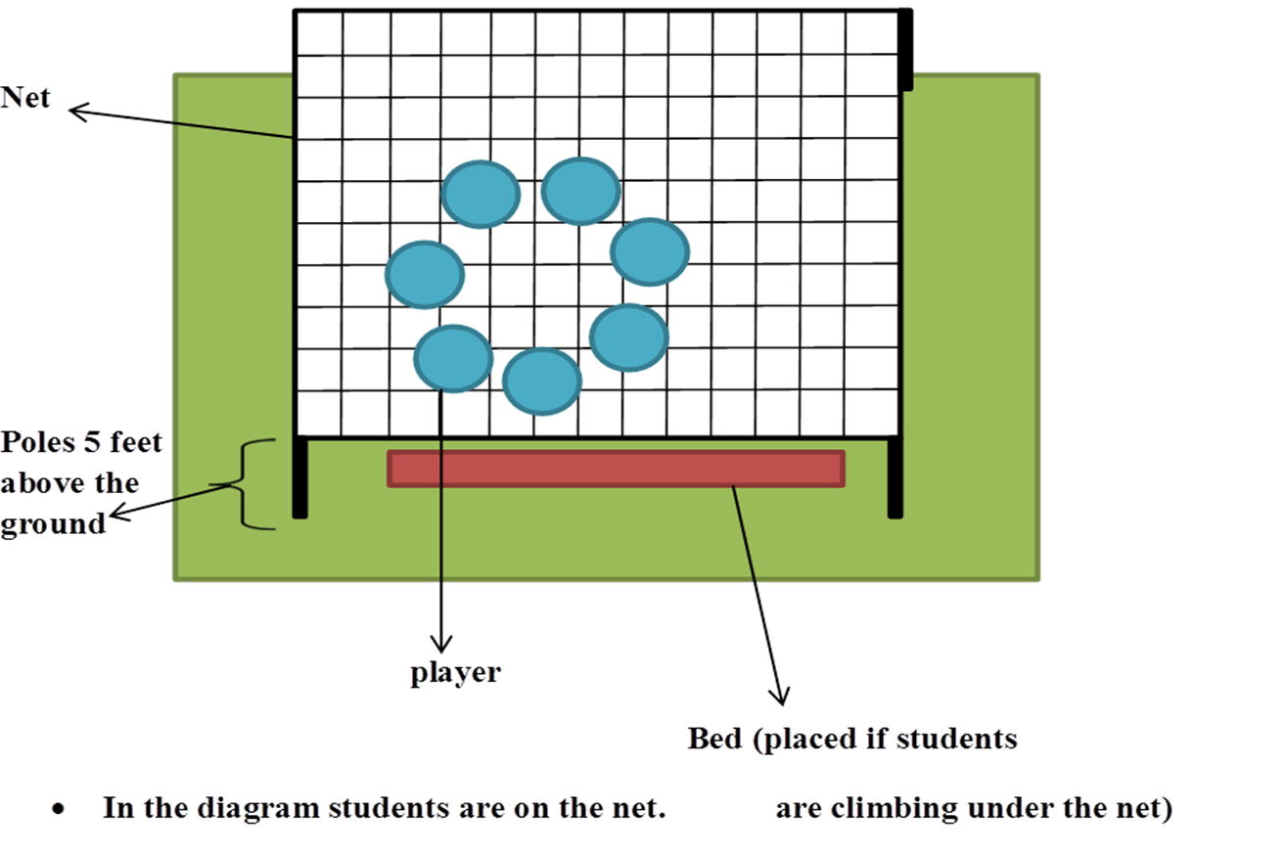
Net diving

Slide 21
